Slide 1
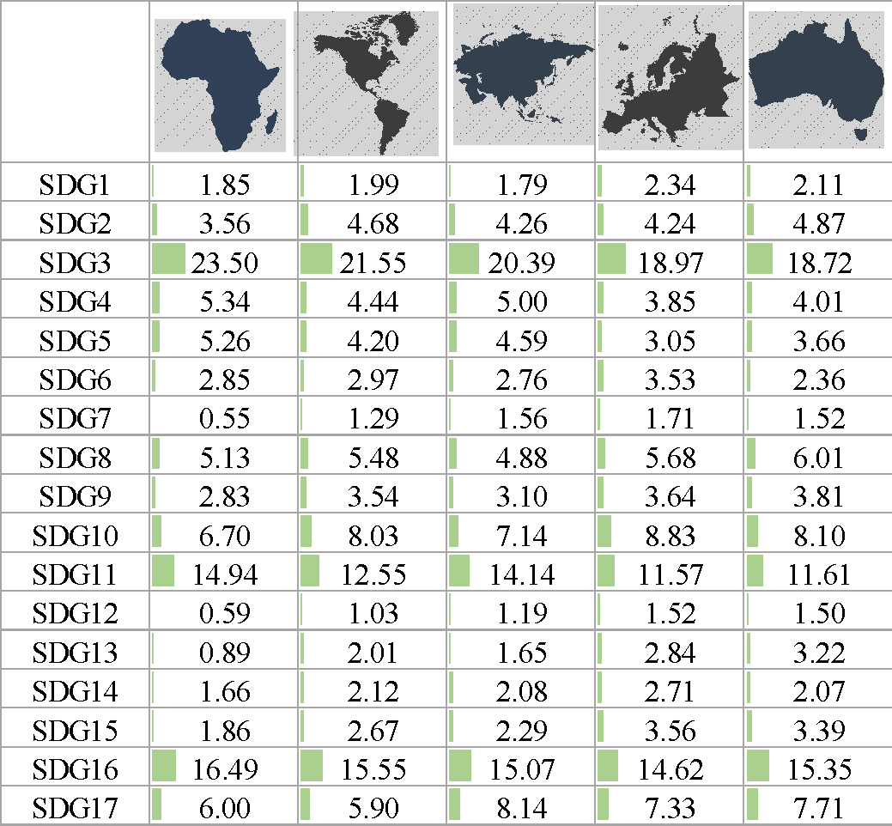
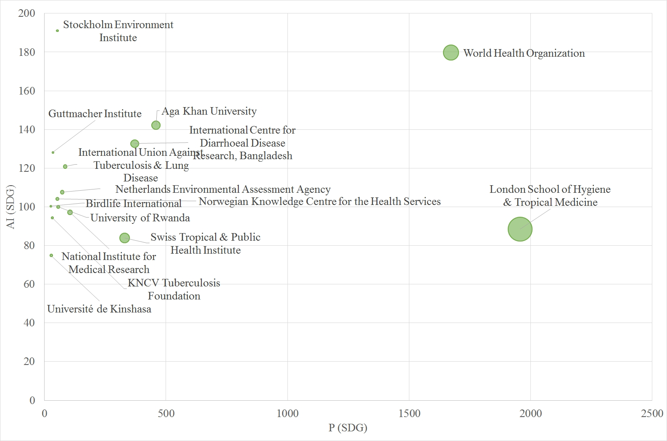
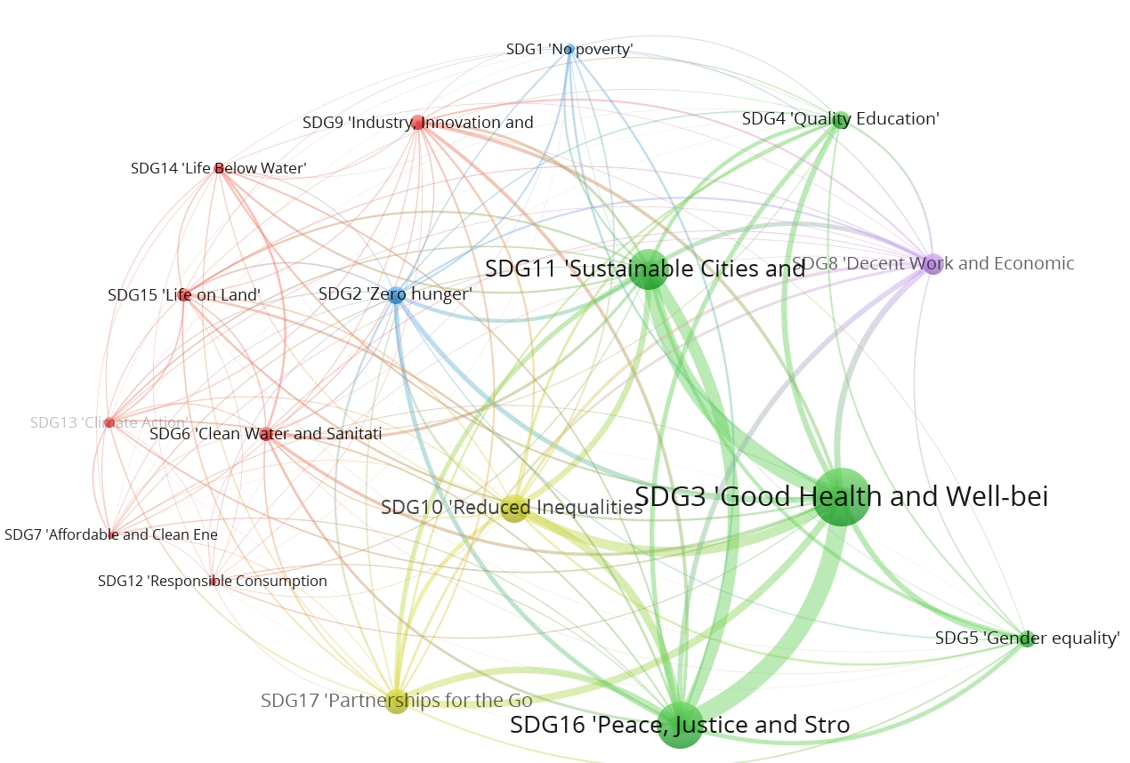
The role of higher education institutions (HEIs) in the path to sustainability: analysis of sustainable development goals (SDGs) from a scientific perspective
Núria Bautista-Puig¹*, Ana Marta Aleixo²,
Elías Sanz-Casado¹ and Ulisses Azeiteiro³
Introduction and Objectives
The Sustainable Development Goals (SDGs) are presented as promising and critical success to respond to societal challenges worldwide. All countries are involved ("No one left behind” lemma) and all stakeholders are involved in the path towards sustainability.
One of the crucial actors is Higher Education Institutions (HEIs) and research centres (RC) who have the lead, within the scope of their mission and their activities related to research, development, and innovation (R&D+i) to respond to this enormous challenge.
The main objective of this poster is to analyse the 'core' scientific output of SDGs from 2000-2017 based on Web of Science, with the aim to map the global research of sustainability at HEIs/research centres.
Methodology
SDG field delineation
SDG seed (n= 4,685)
SDGs Expansion (based on direct citations) 94,614 documents
Citing: 68,202
Cited: 59,050
Dataset of SDGs (2000-2017):
25,645 docs in the period
21,587 University docs
SDG Ontology
1) Key terms based on United Nations(UN) description of each goal
2) Expansion with keywords from the SDG seed
(4,122 terms classified into the 17th SDGs)
Results
25,185 documents (2000-2017) were retrieved from HEIs and research centres.
Increasing tendency of the scientific output (growth of 825%; Cumulative Average Growth Rate of 13.98%).
The most productive countries are: United States (n=8,444, 39.12%), United Kingdom (n=6,03, 27.94%), Switzerland (n=2,225, 10.31%) and Australia (n=1,950 documents, 9.03%).
The most productive institutions are: London School of Hygiene & Tropical Medicine (n=1,957, 9.07%), World Health Organization (WHO) (n=1,672, 7.75%), John Hopkins University (n=1,319, 6.11%).
By continents, the approach of the different SDGs by HEIs and research centres present a similar pattern. The following SDGs stand out from the others: Good Health and Well-Being (SDG3), Peace, Justice and Strong Institutions (SDG16) and Reducing Inequalities (SDG10).
Based on the co-occurrence, 5 clusters are identified.
Distribution of papers per SDGs by Continent
Scatter plot of the Top 20 countries by Activity Index (SDGs)
Co-ocurrence map of SDGs based on a glossary
Conclusions
By analyzing the scientific output, it should be remarked the important participation of HEIs and RC on this research (85.71%). Moreover, the scientific output is recent (32% from 2015-2017).
Regarding the actors, more institutions and countries are being involved in this research over the period (660 institutions and 67 countries in 2000-2005 to 1771 institutions and 95 countries in 2012-2017).
20,825 documents were classified (96.5%) into SDGs based on the glossary. The goals more addressed are related to health (SDG3), peace, justice and strong institutions (SDG16), sustainable cities (SDG11) and reduce inequalities (SDG10).
Regarding the co-occurrence map in the scientific output of HEIs and RC, SDG16-SDG3 and SDG3-SDG11 show a strong connection.
nbautist@bib.uc3m.es; elias@bib.uc3m.es
Research Institute for Higher Education and Science (INAECU), Department of Library and Information Sciences,
University Carlos III of Madrid, Madrid (Spain)
marta.aleixo@ua.pt^{2,3}; ulisses@ua.pt³
² Instituto Politécnico de Leiria, Rua General Norton de Mato
³ CESAM Centre for Environmental and Marine Studies,
University of Aveiro, 3810-193, Aveiro (Portugal)
Acknowledgments: This research was supported by predoctoral contract BES-2015-075461 from the Ministry of Economy and Competitiveness (MINECO).

